Slide 1



Sed
If you think these are weird looking animals, wait until you see the Sed command.
1
Sed: the stream editor

Slide 2
A little disclaimer
2
Sed: the stream editor

Slide 3

Sed was introduced in 1974. The syntax is ugly and random looking. Reading the code 1 month after you wrote it may prove challenging. Enjoy.
Sed goes here
3
Sed: the stream editor

Slide 4
What does Sed do?
4
Sed: the stream editor

Slide 5
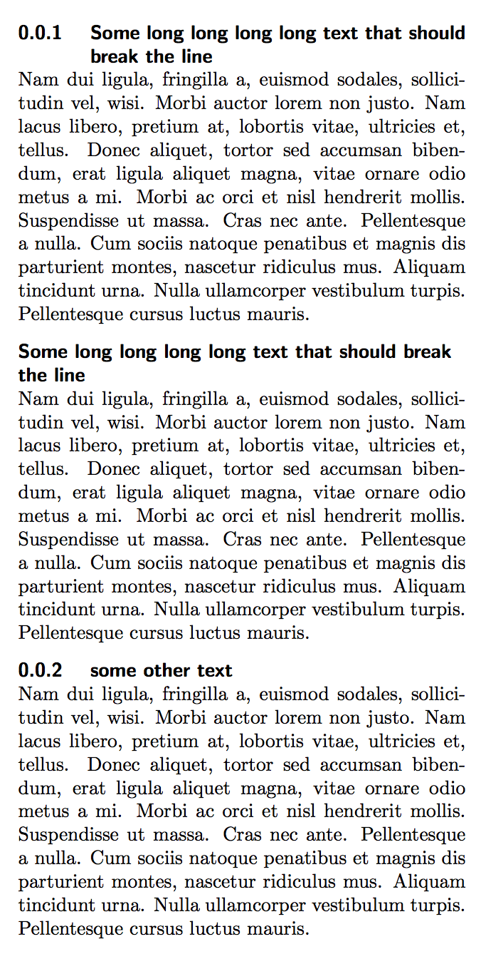

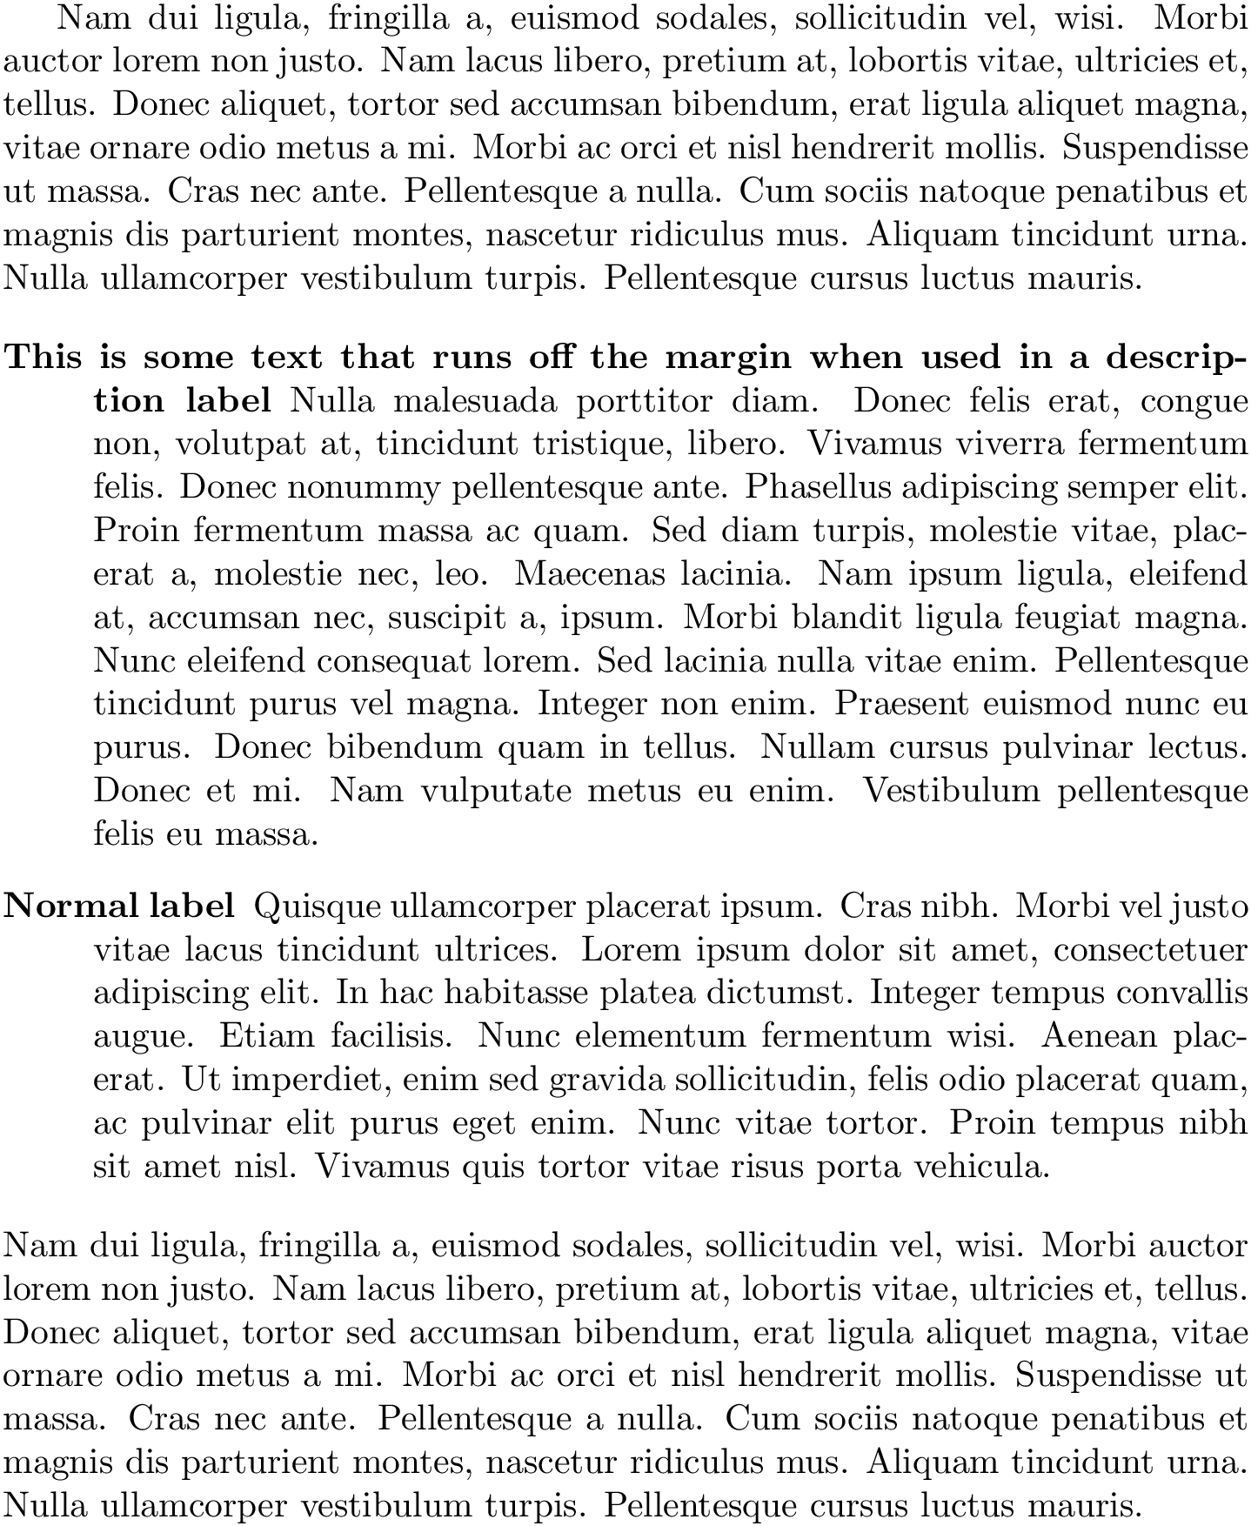
substitute
insert
delete
Takes and edits text
Automatically edit files
Doing the same edit on multiple files
Write conversion programs
5
Sed: the stream editor

Slide 6
Input File
lines
Temporary buffer (pattern space)
sed
(i) Copies input line
(ii) edits
May store all or part of the pattern space for later use
Hold space
For each line until
end of file
outputs
Copies line to pattern space
Applies edit commands
Send processed lines to output
Remove lines from pattern space
6
Sed: the stream editor

Slide 7
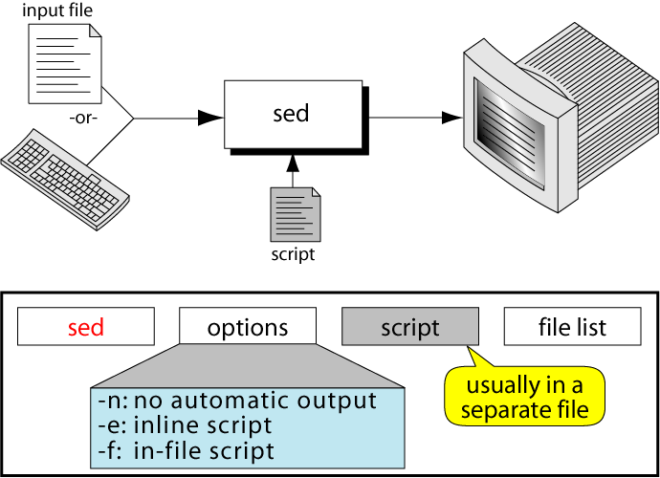
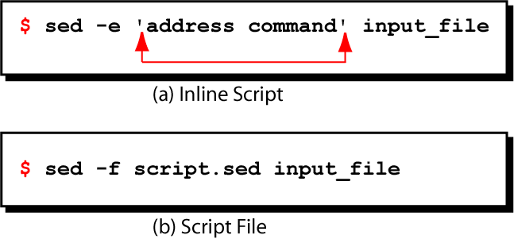
We won’t
7
Sed: the stream editor

Slide 8
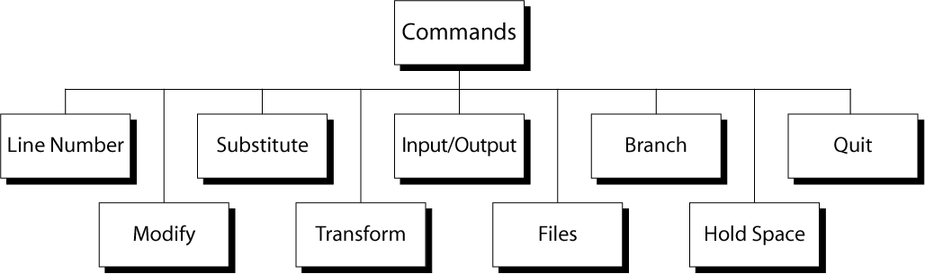
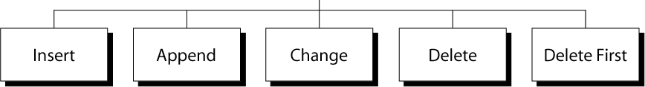
Which lines to process
(if not given then each line is processed)
8
Sed: the stream editor

Slide 9
Substitution of line content
9
Sed: the stream editor

Slide 10
Substitution
-e ‘s/search/replace/[flags]’
Substitute
Regular expression of what you seek to replace
What to replace with
If you use & then it copies the searched part and adds what you want
E.g. g to replace all occurences
Or a number for how many times to replace (by default it’s 1)
10
Sed: the stream editor

Slide 11
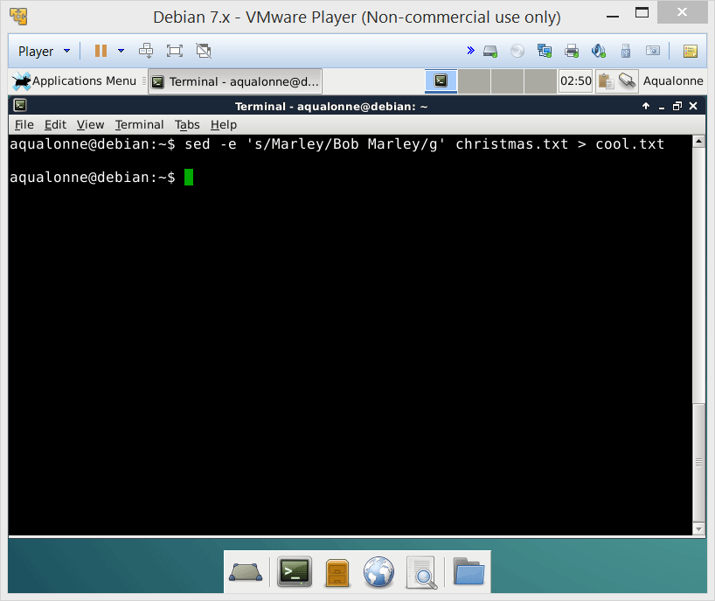
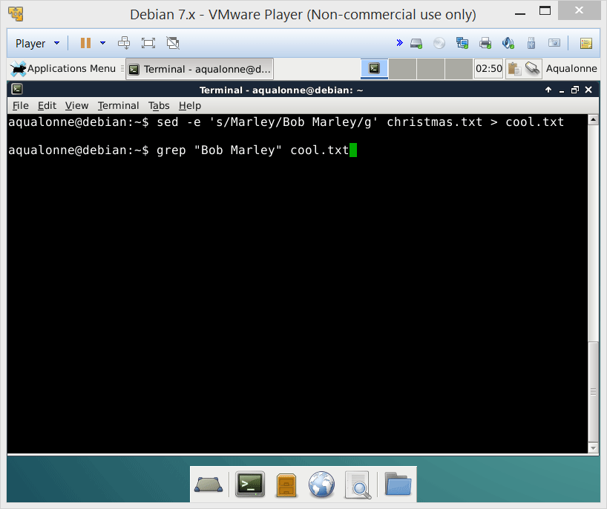

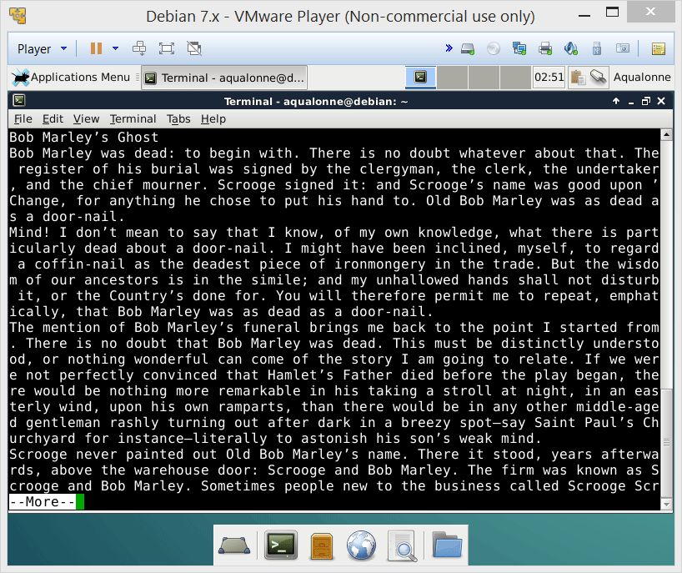

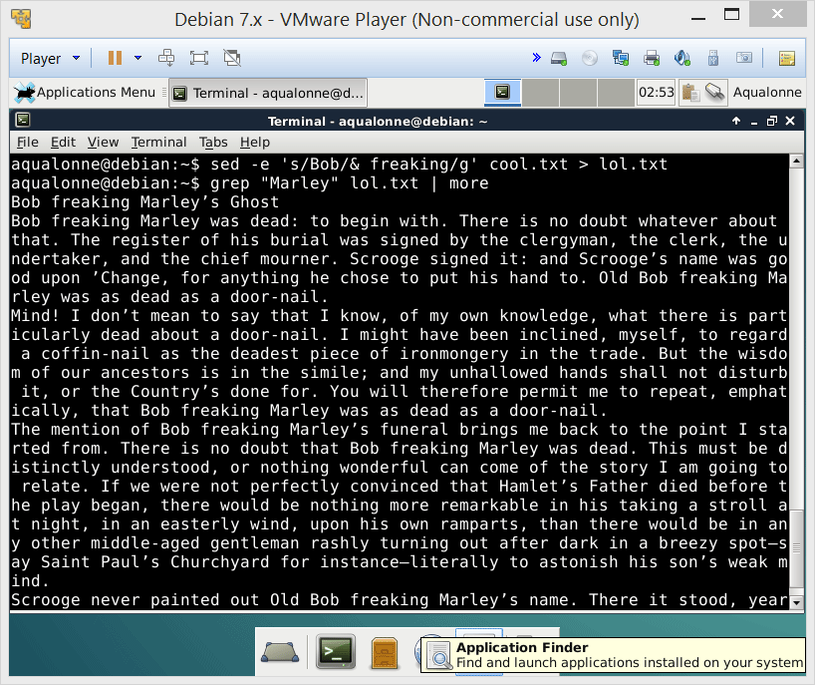
Substitution
If you know exactly what you want to replace, then
sed -e ‘s/text/new/g’ file
11
Sed: the stream editor

Slide 12


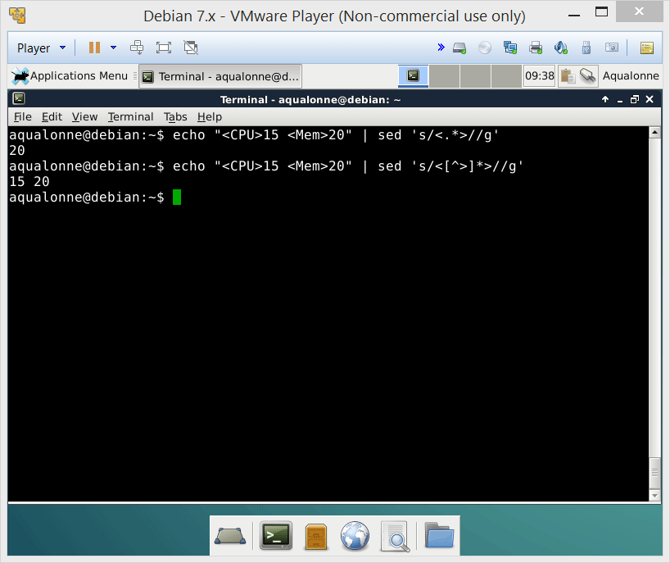

Substitution
To remove something, simply replace it with nothing, like
sed -e ‘s/text//g’
What would you type so you get only the numbers?
sed is greedy. It will grab the longest string that matches your pattern, not the shortest
12
Sed: the stream editor

Slide 13
Substitution
“DeKalb is the location of both a toll plaza and an oasis on Interstate 88. The oasis includes restaurants and a gas station. DeKalb is 30 miles (48 km) west of Aurora and 65 miles (105 km) west from downtown Chicago. The local Voluntary Action Center provides two types of transportation services, TRANS-VAC and MED-VAC. TRANS-VAC provides transportation to activities and businesses in DeKalb County and has two bus routes (the green line and blue line) that runs a regular hourly route Monday through Friday and some limited evening hours for individuals with special needs. MED-VAC provides transportation to out-of-town medical appointments. The NIU Huskie Bus Line serves NIU and the surrounding DeKalb area.”
How would you...
• Replace “DeKalb” by “Happy Corn Land”?
sed ‘s/DeKalb/Happy Corn Land/g’
• Add “, IL” after “DeKalb”?
sed ‘s/DeKalb/&, IL/g’
• Remove the distance in km?
sed ‘s/[[:space:]]([[:digit]]*[[:space:]]km)//g’
13
Sed: the stream editor

Slide 14
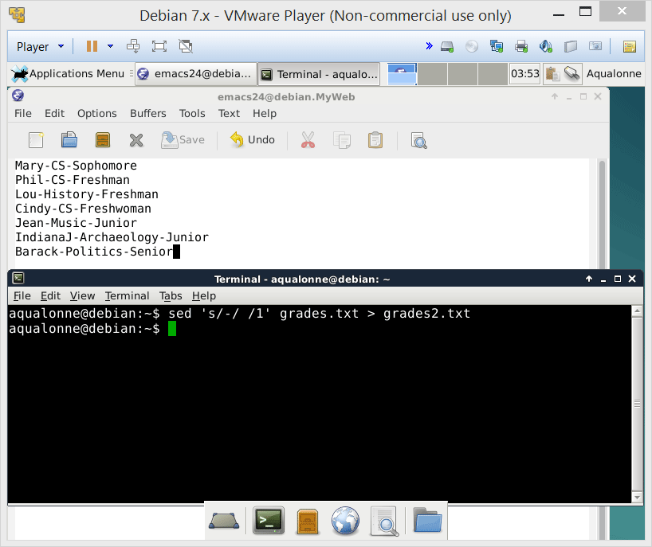
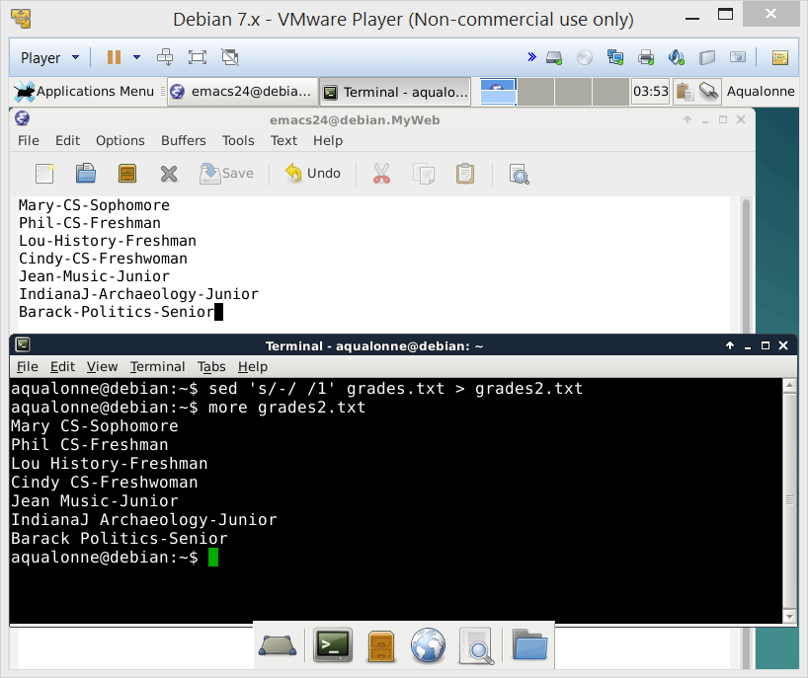
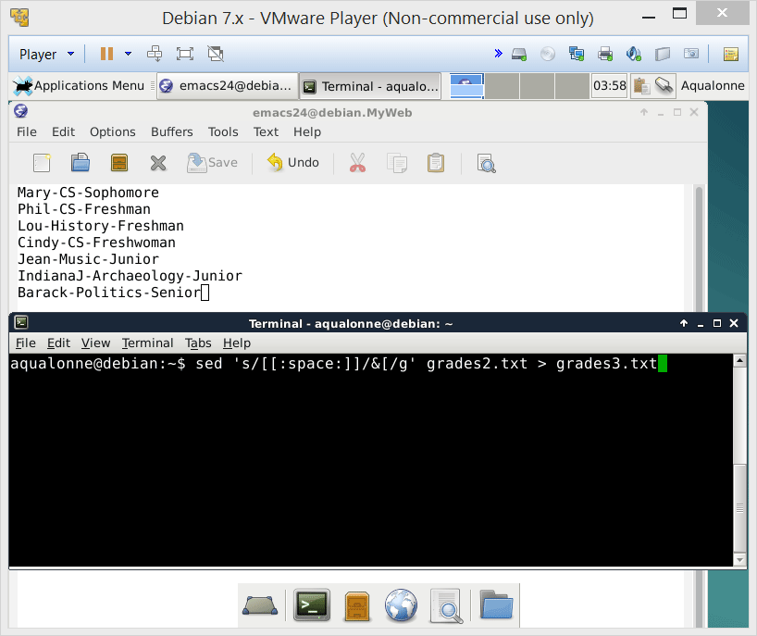
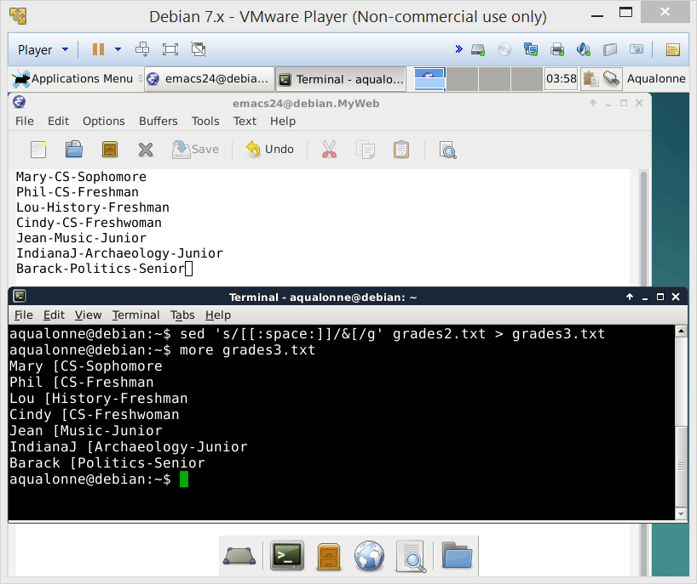
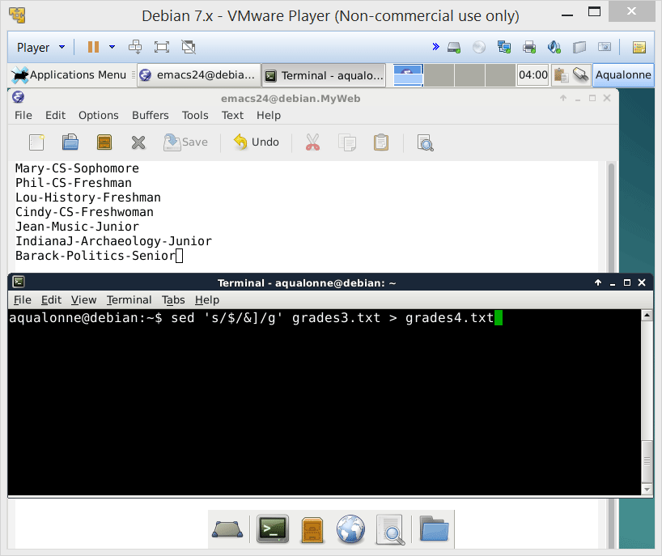


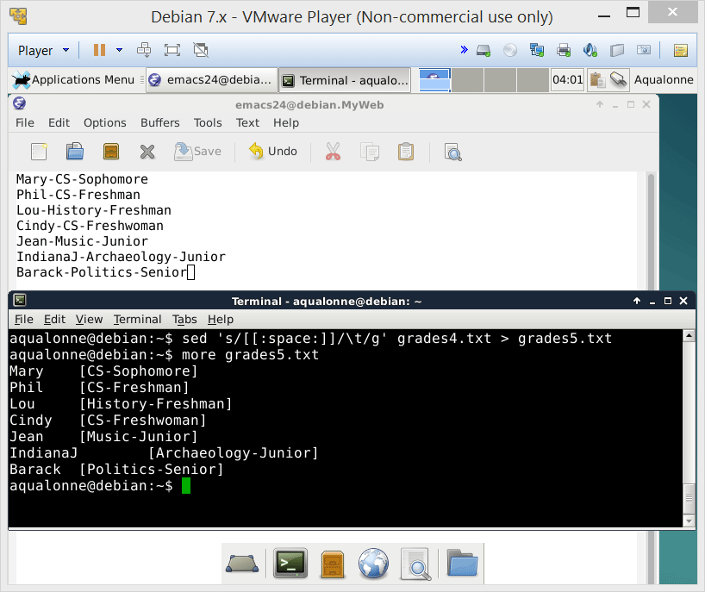
Substitution
If your pattern occurs several times per line but you don’t want to replace all occurrences
then
sed -e ‘s/text/new/num’ file
position of the pattern in each line
14
Sed: the stream editor

Slide 15
Substitution
You can use back references to change the ordering of the line.
Mary
Phil
Lou
Cindy
CS-Sophomore
CS-Freshman
History-Freshman
CS-Freshwoman
sed -e ‘s/\( \)\( \)/\( \)\( \) /g’
CS-Sophomore
CS-Freshman
History-Freshman
CS-Freshwoman
Mary
Phil
Lou
Cindy
15
Sed: the stream editor

Slide 16
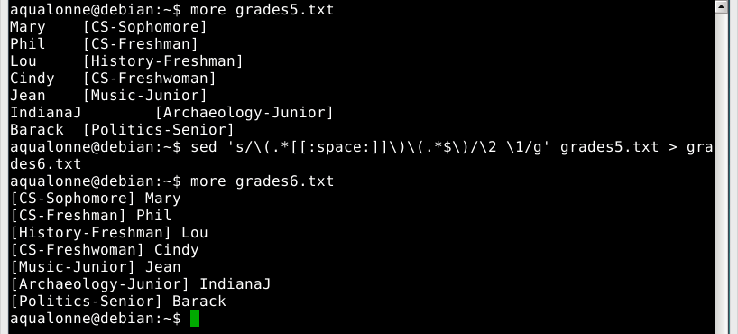
Substitution
16
Sed: the stream editor

Slide 17
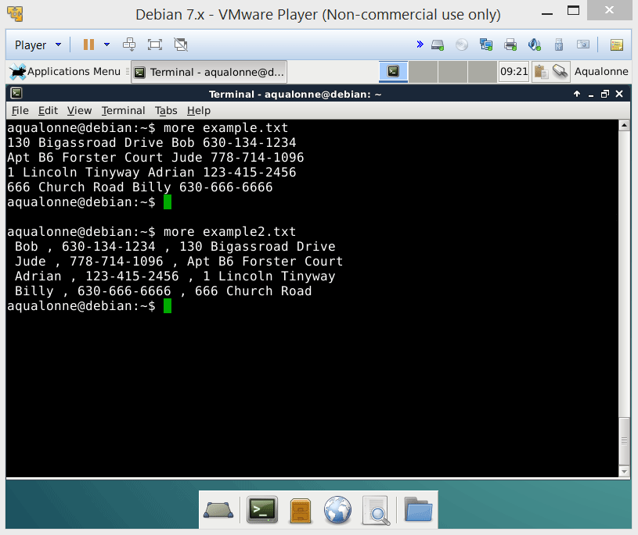

Substitution
???
How can we remove this first space?
17
Sed: the stream editor

Slide 18

Substitution
18
Sed: the stream editor

Slide 19
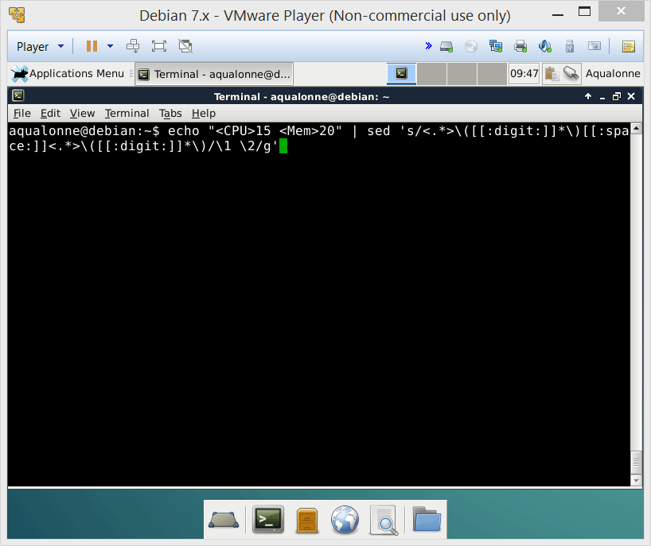
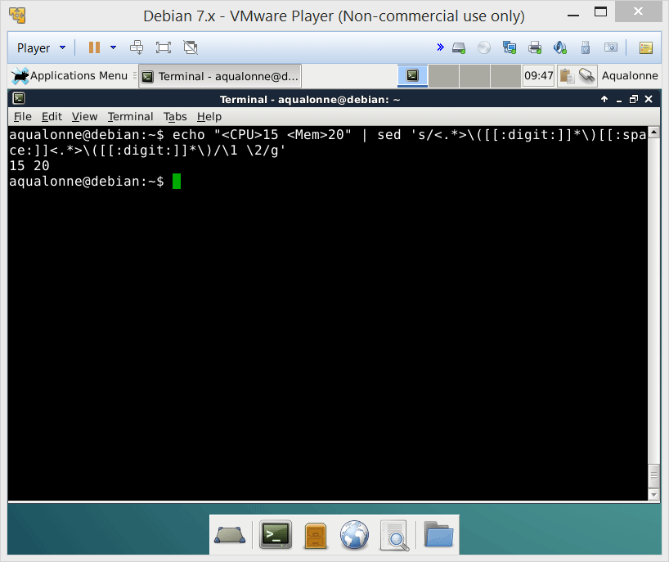

Substitution
Back references make sense when the result is reordered. If you wanted memory first instead of CPU, it’d be ok...
If the ordering isn’t changing then there may be a simpler way to write it!
What does this do?
19
Sed: the stream editor

Slide 20
Substitution
“DeKalb is the location of both a toll plaza and an oasis on Interstate 88. The oasis includes restaurants and a gas station. DeKalb is 30 miles (48 km) west of Aurora and 65 miles (105 km) west from downtown Chicago. The local Voluntary Action Center provides two types of transportation services, TRANS-VAC and MED-VAC. TRANS-VAC provides transportation to activities and businesses in DeKalb County and has two bus routes (the green line and blue line) that runs a regular hourly route Monday through Friday and some limited evening hours for individuals with special needs. MED-VAC provides transportation to out-of-town medical appointments. The NIU Huskie Bus Line serves NIU and the surrounding DeKalb area.”
How would you...
• Swap the distances in kilometers and miles, e.g. DeKalb is 48 km (30 miles) ...
• Keep only the distance in kilometers, using back referencing?
• Keep only the distance in kilometers, without back referencing?
20
Sed: the stream editor

Slide 21
About one liners…
21
Sed: the stream editor

Slide 22
About one liners
the programmer who writes code like that
A one-liner program performs some function in only one line (=until you hit Enter)
main(v,c)char**c;{for(v[c++]="Hello, world!\n)";(!!c)[*c]&&(v--||--c&&execlp(*c,*c,c[!!c]+!!c,!c));**c=!c)write(!!*c,*c,!!**c);}
extract=$(echo "$benchmark" | sed 's/<\/\?[^>]\+>//g')
These programs were mostly around in the late 70s and 80s.
22
Sed: the stream editor

Slide 23
About one liners
“Our model was that an invocation would be one or two lines long, typed in and used immediately. Defaults were chosen to match this style [...] We, being the authors, knew how the language was supposed to be used, and so we only wrote one-liners.”
AWK manual
22
Sed: the stream editor

Slide 24

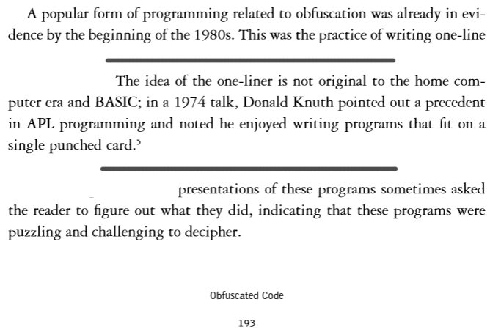
About one liners
23
Sed: the stream editor

Slide 25

About one liners
And last night I finally figured out what that sed one-line does
24
Sed: the stream editor

Slide 26
About one liners
Programs have to be readable so they can be debugged, maintained, etc.
The goal is never to write the shortest possible program. A program won’t even run faster if it’s written smaller, that bears no relation!
You can use sed for admin tasks like filtering log files or adding a title to a bunch of files. But you do not do data science with sed.
25
Sed: the stream editor

Slide 27

About one liners
If you want to know more about one-liners, read One-liner program on Wikipedia
If you want to know more about re-formatting data, read Data wrangling on Wikipedia
26
Sed: the stream editor

Slide 28



About one liners
27
Sed: the stream editor

Slide 29
Modify commands do not edit the content of the line. The line is the smallest unit for modify. You can insert lines, delete lines, change the whole line into something else...
28
Sed: the stream editor

Slide 30
Modify: insert, append, change, delete
29
Sed: the stream editor

Slide 31
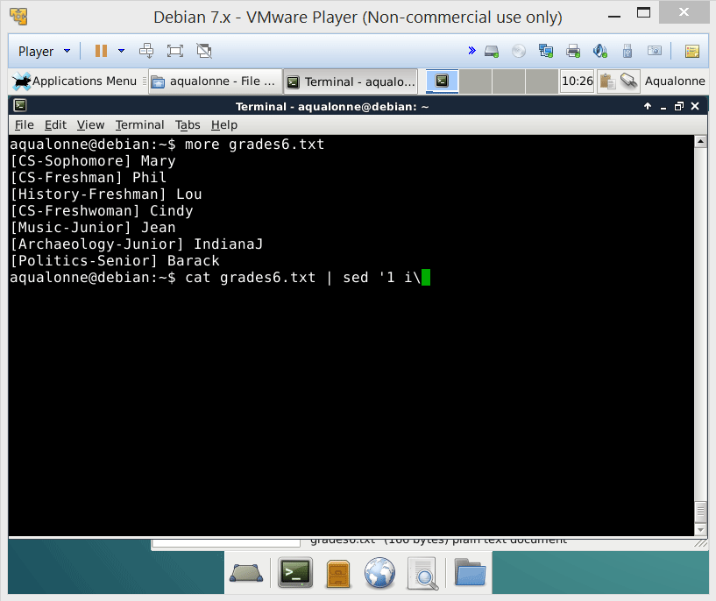

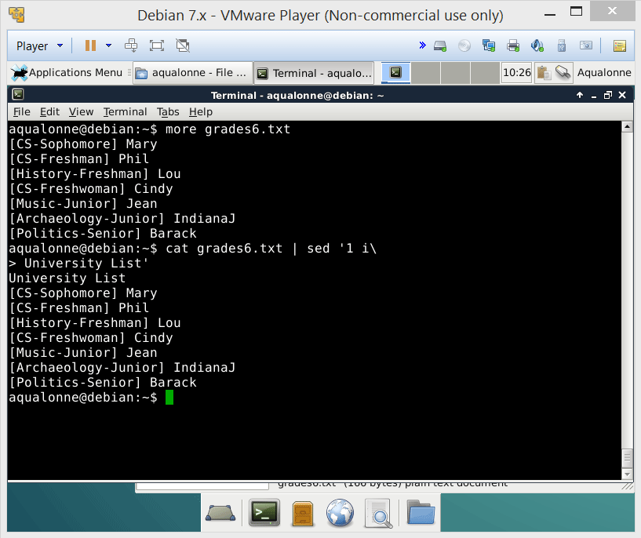

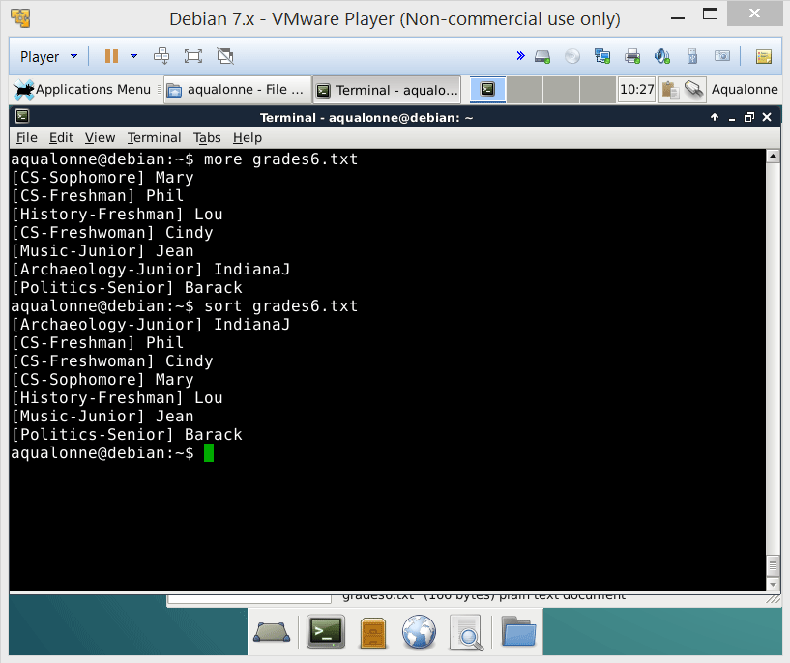
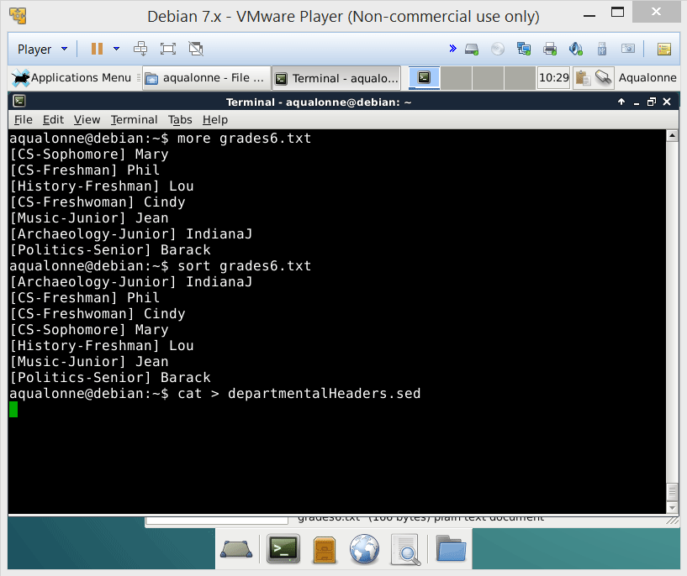
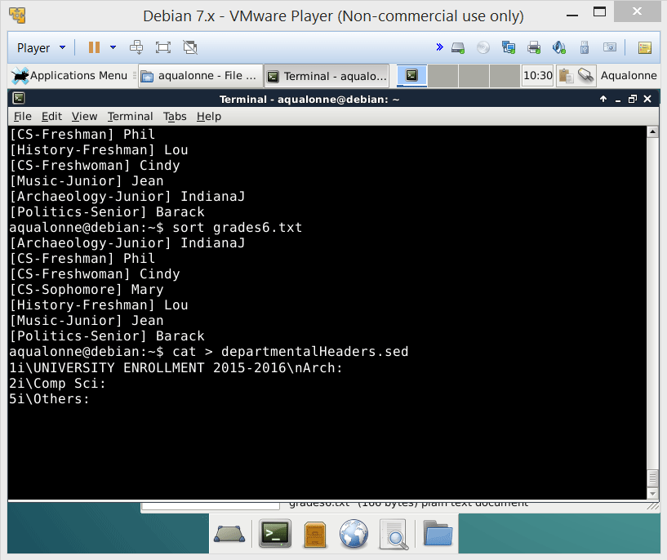
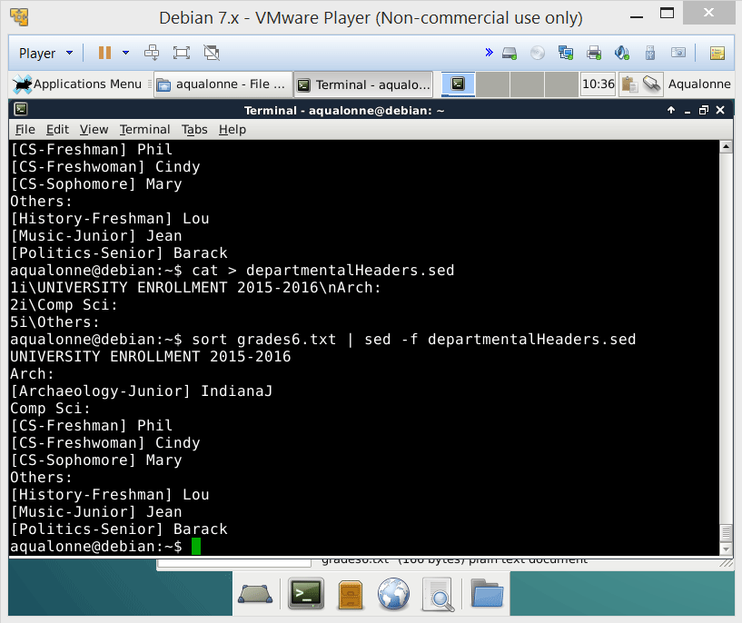
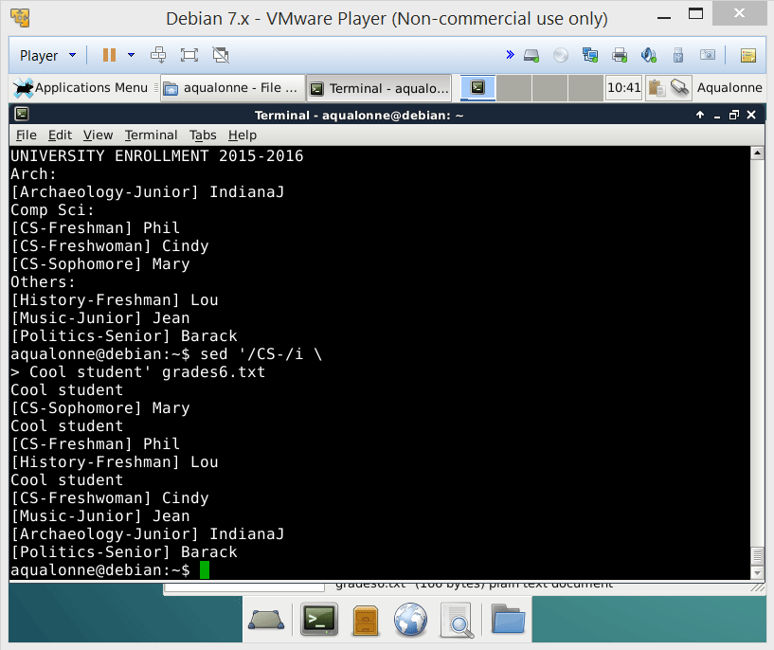
Modify: insert, append, change, delete
insert will add lines before the target either by pattern or by line number
If you want to add lines here and there, write a sed script and give it via sed -f
30
Sed: the stream editor

Slide 32
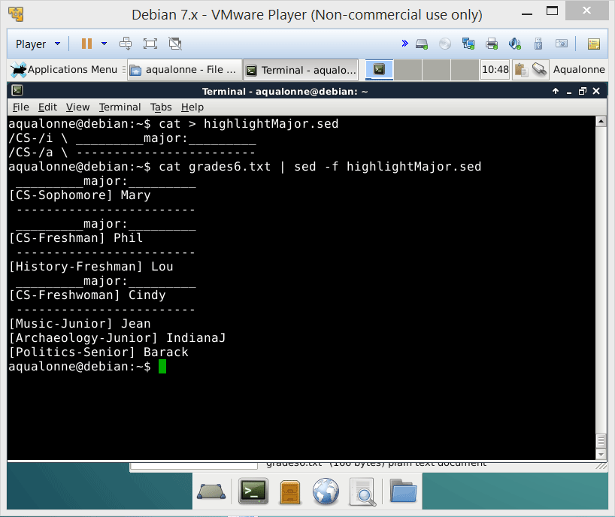
Modify: insert, append, change, delete
While insert creates lines before, append creates lines after.
You can combine append and insert in scripts to isolate interesting data points.
31
Sed: the stream editor

Slide 33
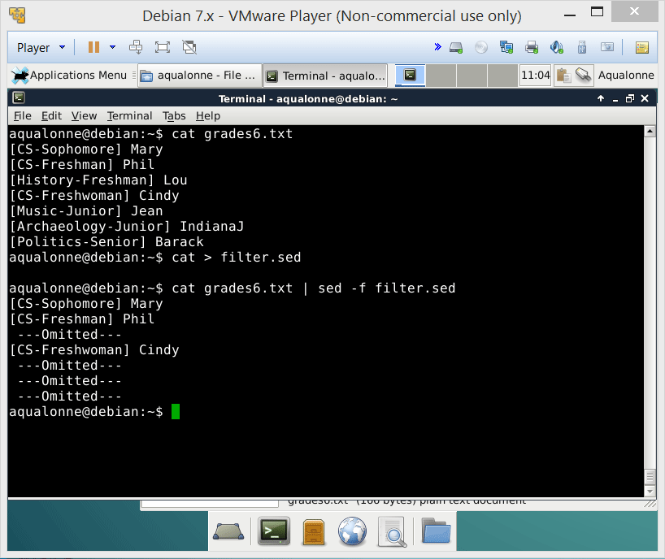

Modify: insert, append, change, delete
change is used to replace a whole line by another one(s)
????
For example you can use this to do error correction or filter while leaving a note.
32
Sed: the stream editor

Slide 34
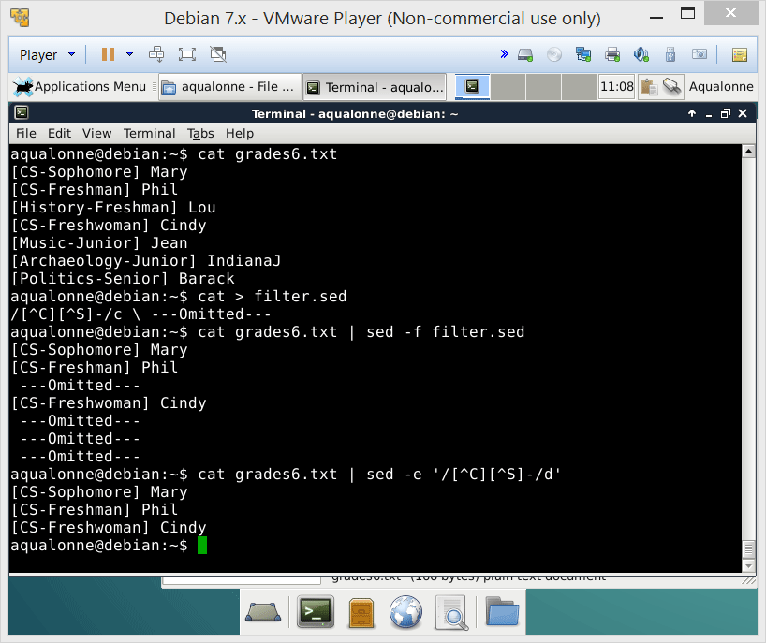
Modify: insert, append, change, delete
delete is used to delete. What else did you think it’d do anyway ;-)?
33
Sed: the stream editor

Slide 35

Modify: insert, append, change, delete
In your current folder, there are only text files. Write a script that adds the line “Written by Joe” at the beginning of each file.
#!/bin/bash
for file in * ; do
#inserts the line “Written by Joe” at top of file
cat “$file” | sed ‘1 i\Written by Joe’
done
34
Sed: the stream editor

Slide 36
Modify: insert, append, change, delete
Write a script that adds “(c) Dr Phil 2015” to all Bash scripts found in the current folder.
#!/bin/bash
for file in *.sh ; do
#inserts the line “Written by Joe” at top of file
cat “$file” | sed ‘2 i\#(c) Dr Phil 2015’
done
Because the Sheband line should still be first
35
Sed: the stream editor

Slide 37

Modify: insert, append, change, delete
John scanned a bunch of books and made text files. The title of the book is the file’s name. John realizes that he forgot to write the title in the books. Write a script to fix that.
36
Sed: the stream editor

Slide 38


From single to multi-line patterns
37
Sed: the stream editor

Slide 39
From single to multi-line patterns
Input File
lines
sed processes the file line per line. But you can read a new line of input and append it to the pattern space.
This is done using the Next command.
It serves to handle patterns that spawn multiple lines.
sed
\n
Temporary buffer (pattern space)
38
Sed: the stream editor

Slide 40
From single to multi-line patterns
If this word ends the sentence
Consult Section 3.1 in the Owner and Operator
Guide to know how to operate your kettle.
Consult Section 3.1 in the book
to know how to operate your kettle.
Consult Section 3.1 in the Owner and Operator
Guide to know how to operate your kettle.
/Operator$/{
N
s/Owner and Operator\nGuide/book\
/
}
line break
\n
book
39
Sed: the stream editor

Slide 41
From single to multi-line patterns
In practice you rarely know when your expression breaks over multiple lines. For example if you’re replacing text in a scanned book, the expression may be in a single line or two...
Then the ghosts walked into a bar with Scrooge and Marley and they had a good time.
Then the ghosts walked into a bar with good fellows and they had a good time.
Then the ghosts walked into a bar with Scrooge and Marley and they had a good time.
Then the ghosts walked into a bar with good fellows and they had a good time.
So it makes sense to prepare for a pattern that may be over two lines (=separated by \n) or not (=separated by space).
40
Sed: the stream editor

Slide 42
From single to multi-line patterns
/Scrooge/{
N
s/Scrooge *\n*and *\n*Marley/good fellows/
\
}
*
Words may be separated by a space or by a newline
\n*
So it makes sense to prepare for a pattern that may be over two lines (=separated by \n) or not (=separated by space).
41
Sed: the stream editor

Slide 43
From single to multi-line patterns
Not only can you replace content that spawns multiple lines, but you can also get rid of duplicate lines. If one line matches your pattern and the next also does, then just output one.
For example, let’s replace multiple empty lines by just one.
What’s the pattern?
/^$/
{
N
/^\n$/d
}
delete
42
Sed: the stream editor

Slide 44
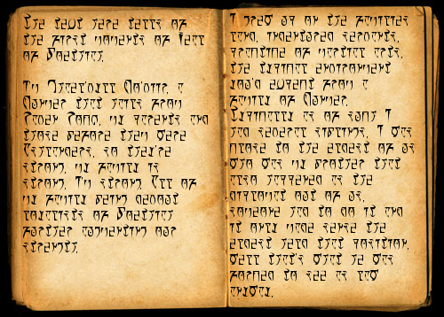

From single to multi-line patterns
What do you think this script does?
s/@f1(\([^)]*\))/\\fB\1\\fR/g
/@f1(.*/{
N
s/@f1(\(.*\n[^)]*\))/\\fB\1\\fR/g
}
Just kidding. You may as well try to read this...
43
Sed: the stream editor

Slide 45

Branching a.k.a… conditionals
44
Sed: the stream editor

Slide 46
Branching
So far you have only processed lines that contain a pattern.
But sometimes you want to process lines that contain the pattern in one way, and lines that don’t have it in another way.
Departmental list
Mary CS-Sophomore
Phil CS-Freshman
Cindy CS-Freshwoman
Mary CS-Sophomore
Phil CS-Freshman
Lou History-Freshman
Cindy CS-Freshwoman
Jean Music-Junior
IndianaJ Archaeology-Junior
Barack Politics-Senior
Lou History-Freshman
Jean Music-Junior
IndianaJ Archaeology-Junior
Barack Politics-Senior
Someone-else-problem list
45
Sed: the stream editor

Slide 47
Branching
/CS-/b department
w others.txt
b
:department
w departmentList.txt
If you see the pattern “CS-” then branch to the part of the script labelled :department
Write line to the file others.txt
handles non-CS
Branch. If not target, then end of script.
handles CS
Write line to the department’s list
Mary CS-Sophomore
Lou History-Freshman
Cindy CS-Freshwoman
Phil CS-Freshman
Jean Music-Junior
Mary CS-Sophomore
Lou History-Freshman
46
Sed: the stream editor

Slide 48


